Slide 1

Pigeon Pooper

Slide 2
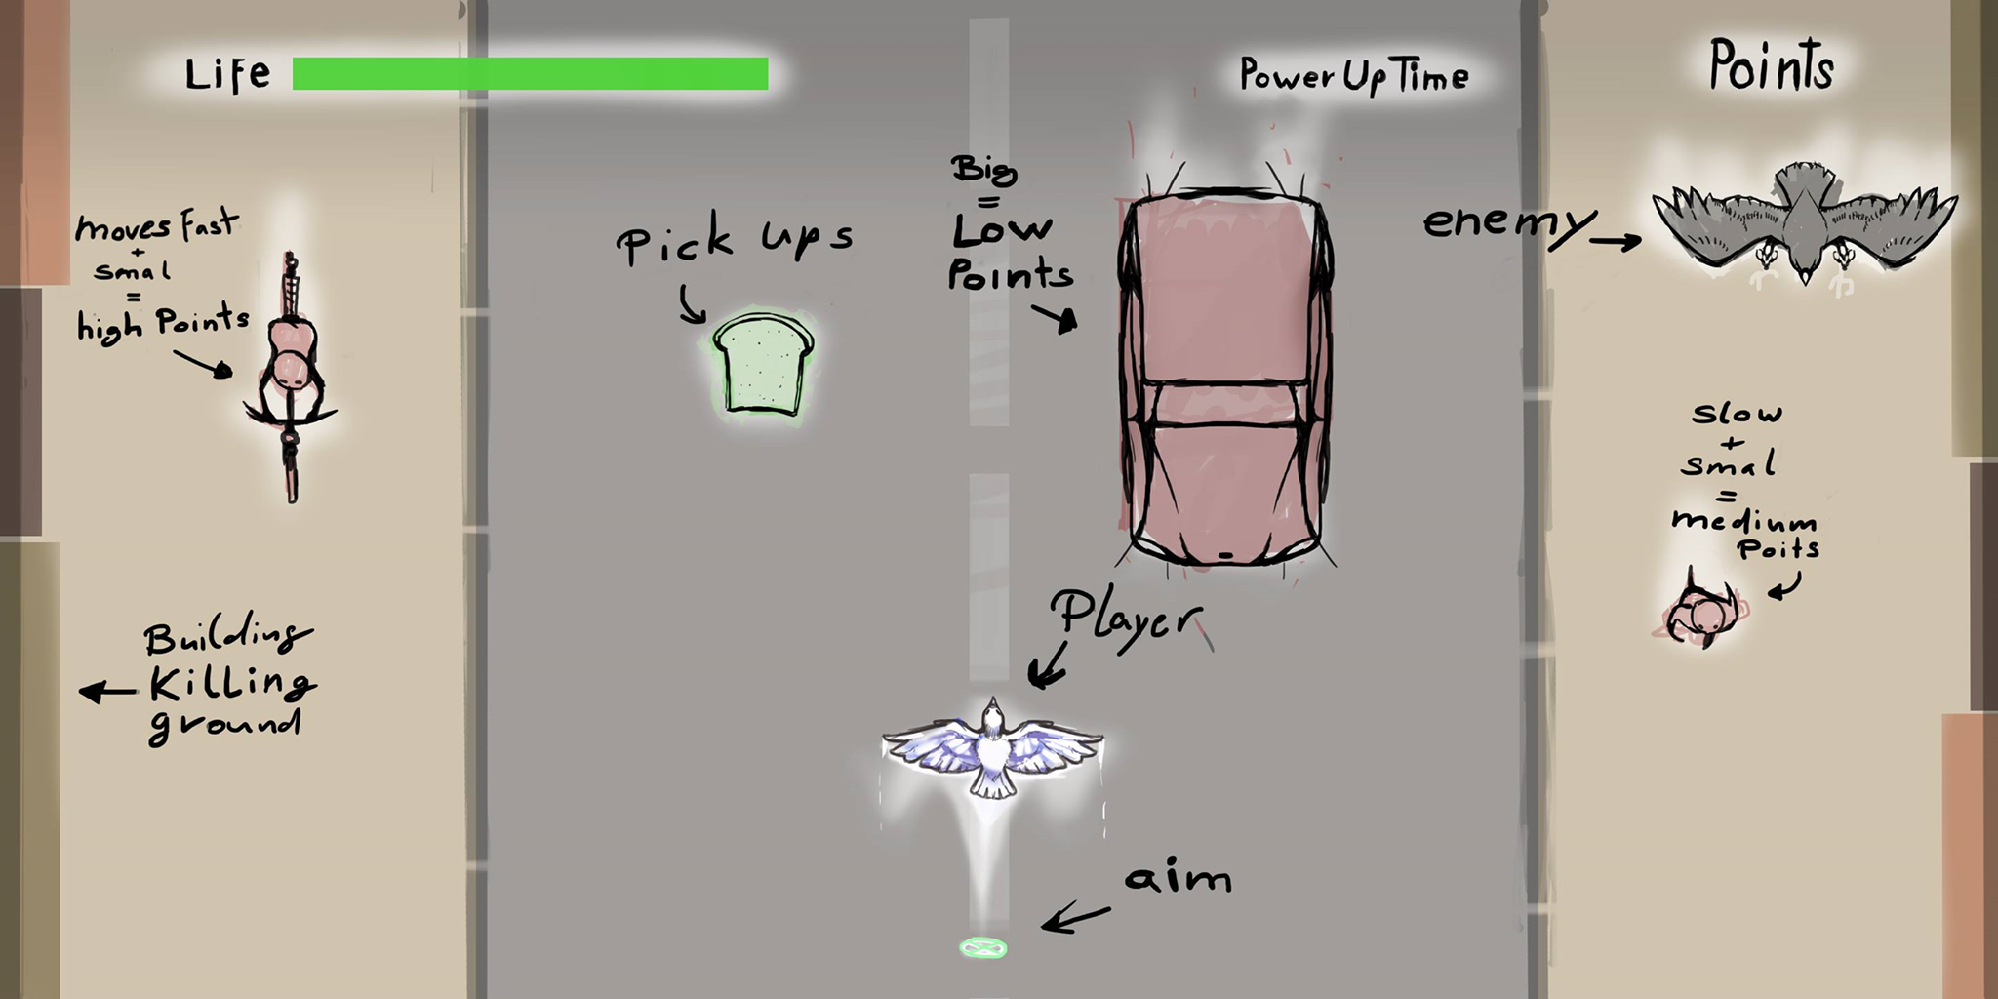
Game Design

Slide 3
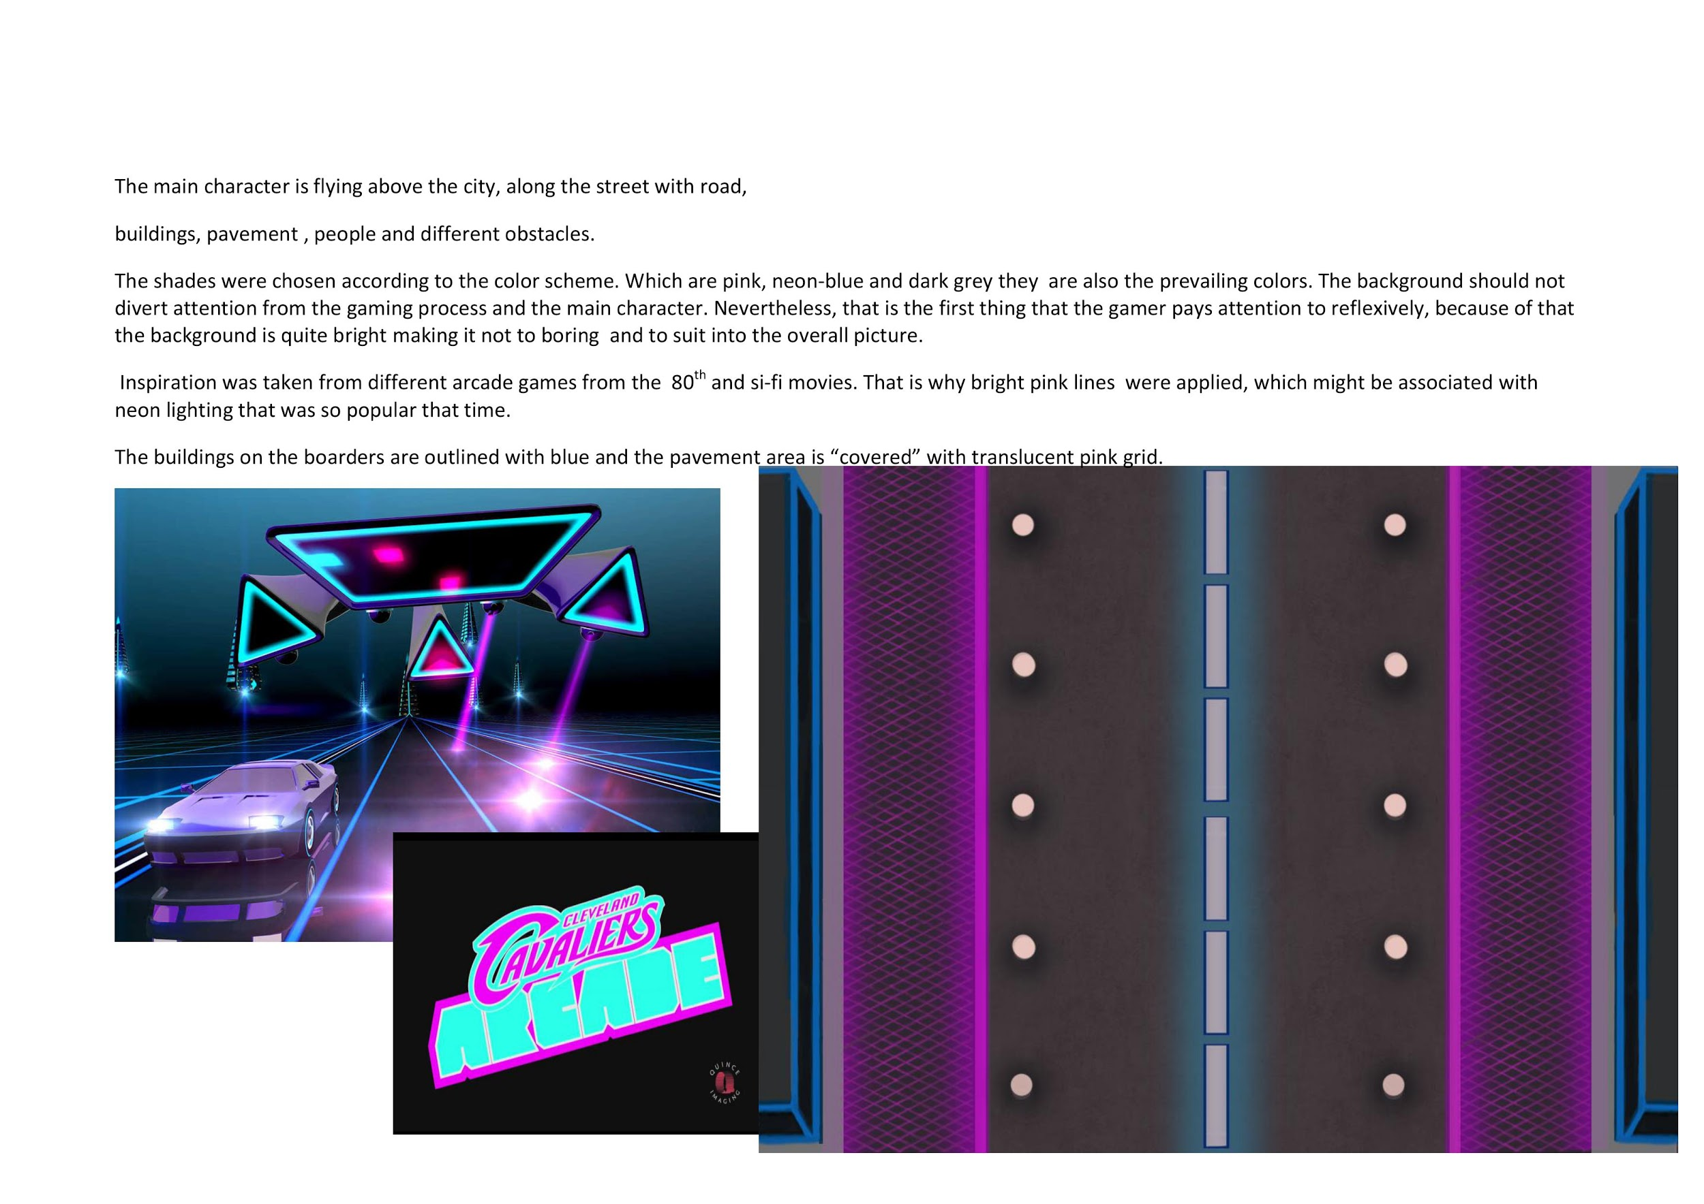
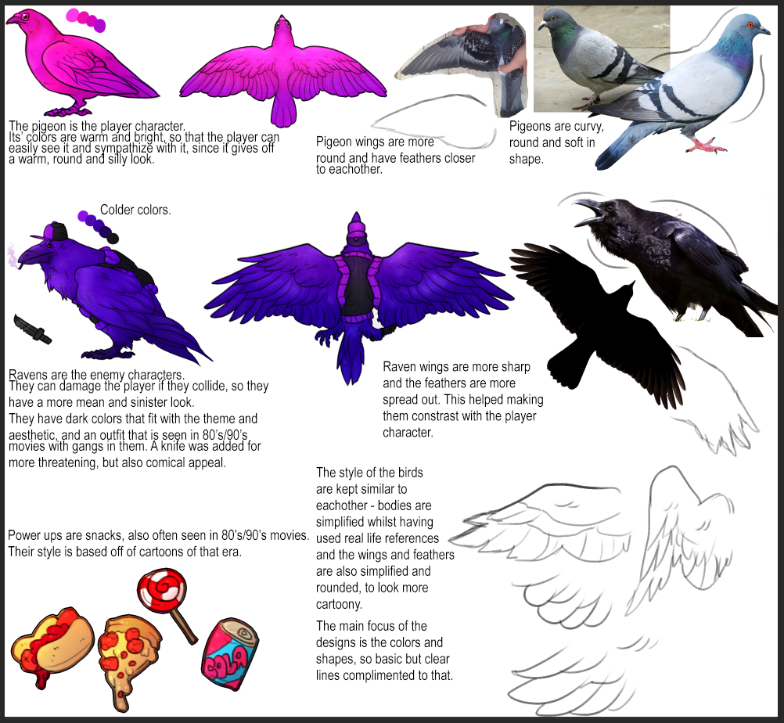
Art Design

Slide 4
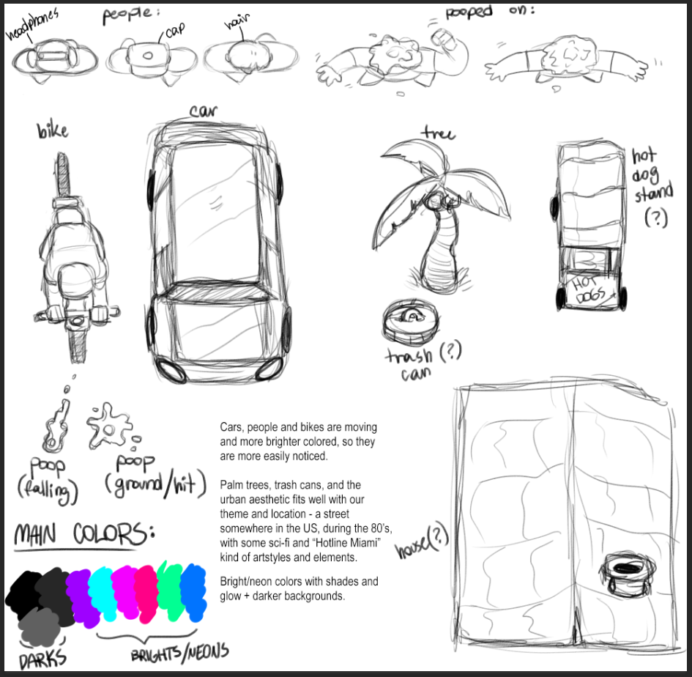
Art Design

Slide 5


Sound Design

Slide 6
Planning
Scrum

